Slide 1
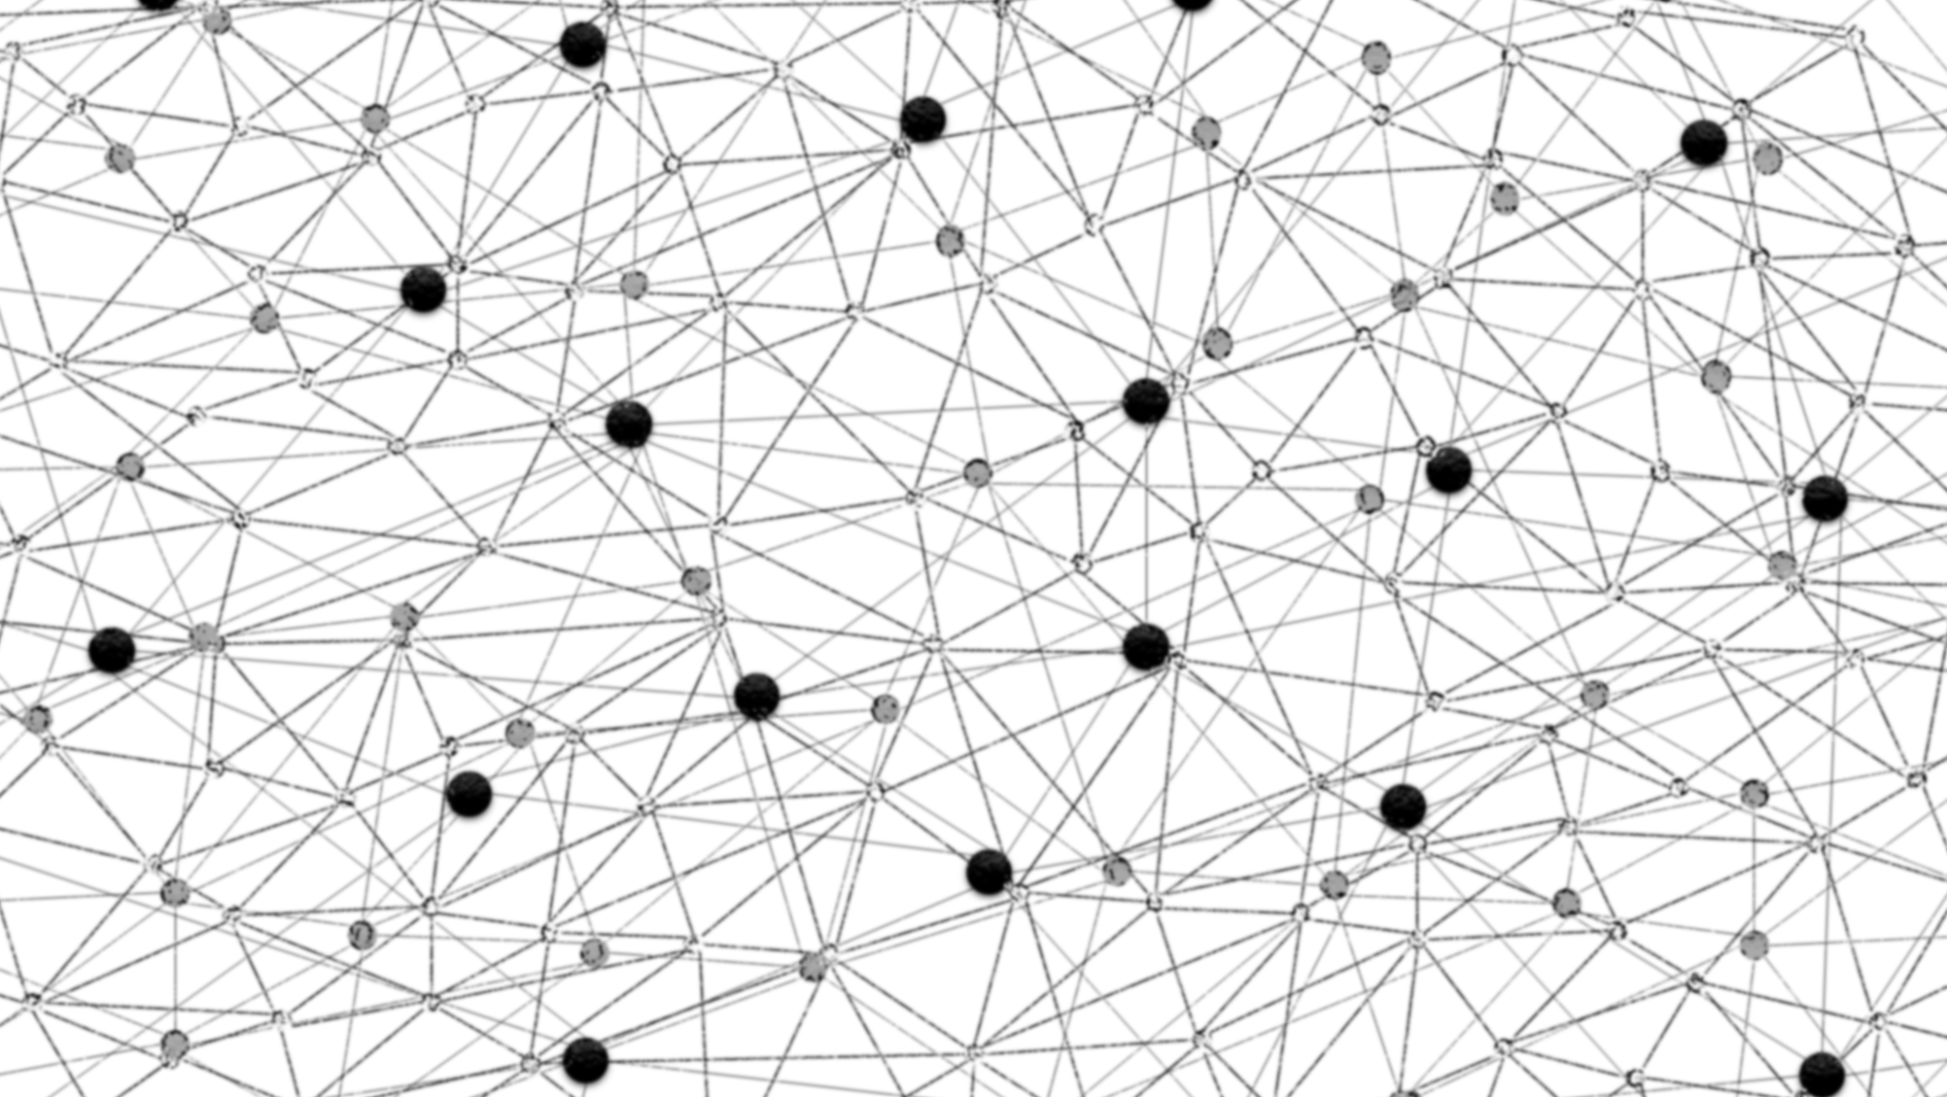
A Simple Introduction to Word Embeddings
Bhaskar Mitra, Microsoft (Bing Sciences)

Slide 2
The value of science is not to make things complex, but to find the inherent simplicity.
- Frank Seide

Slide 3
Vector Space Models
Represent an item (e.g., word) as a vector of numbers.
banana
0
1
0
1
0
0
2
0
1
0
1
0

Slide 4
Vector Space Models
Represent an item (e.g., word) as a vector of numbers.
The vector can correspond to documents in which the word occurs.
banana
0
1
0
1
0
0
2
0
1
0
1
0
Doc2
Doc4
Doc7
Doc9
Doc11

Slide 5
Vector Space Models
Represent an item (e.g., word) as a vector of numbers.
The vector can correspond to neighboring word context.
e.g., “yellow banana grows on trees in africa”
banana
0
1
0
1
0
0
2
0
1
0
1
0
(yellow, -1)
(on, +2)
(grows, +1)
(tree, +3)
(africa, +5)
-1
0
+1
+2
+3
+4
+5

Slide 6
Vector Space Models
Represent an item (e.g., word) as a vector of numbers.
The vector can correspond to character trigrams in the word.
banana
0
1
0
1
0
0
2
0
1
0
1
0
#ba
na#
ana
nan
ban

Slide 7
Notions of Relatedness
Comparing two vectors (e.g., using cosine similarity) estimates how similar the two words are. However, the notion of relatedness depends on what vector representation you have chosen for the words.
or
seattle similar to denver?
Because they are both cities.
seattle similar to seahawks?
Because “Seattle Seahawks”.
(Go Seahawks!)
Important note: In previous slides I showed raw counts. They should either be normalized (e.g., using pointwise-mutual information) or (matrix) factorized. More on that later…

Slide 8
Let’s consider the following example…
We have four (tiny) documents,
Document 1 : “seattle seahawks jerseys”
Document 2 : “seattle seahawks highlights”
Document 3 : “denver broncos jerseys”
Document 4 : “denver broncos highlights”

Slide 9
If we use document occurrence vectors…
Document 1
Document 3
Document 2
Document 4
seattle
1
1
0
0
similar
seahawks
1
1
0
0
denver
0
0
1
1
similar
broncos
0
0
1
1
In the rest of this talk, we refer to this notion of relatedness as Topical similarity.

Slide 10
If we use word context vectors…
(seattle, -1)
(denver, -1)
(jerseys, + 1)
(highlights, +1)
(seahawks, +1)
(broncos, +1)
(jerseys, + 2)
(highlights, +2)
seattle
0
2
0
0
0
1
0
1
seahawks
2
0
0
0
1
0
1
0
similar
denver
0
0
0
2
0
1
0
1
similar
broncos
0
0
2
0
1
0
1
0
In the rest of this talk, we refer to this notion of relatedness as Typical (by-type) similarity.

Slide 11
If we use character trigram vectors…
#se
set
ett
ttl
le#
sea
eat
att
tle
seattle
1
1
0
1
0
1
1
1
1
similar
settle
1
0
1
0
1
0
1
1
1
This notion of relatedness is similar to string edit-distance.

Slide 12
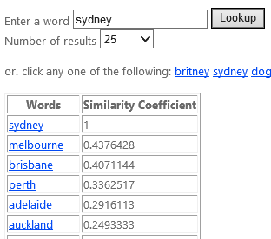
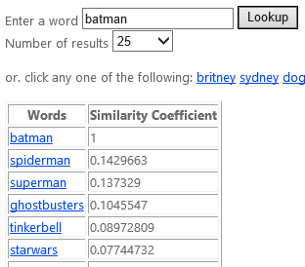
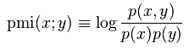
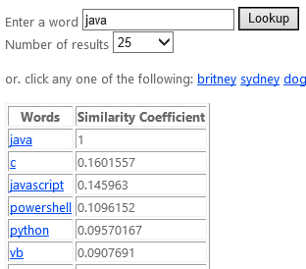
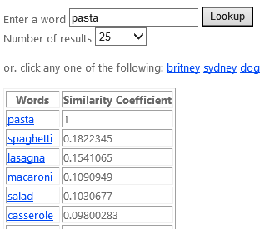
DIY: Learning Word Types
Take a sentence or query corpus and extract Word-Context pairs, where Context is the <neighbouring word, distance> tuple.
Compute (Positive) Pointwise Mutual Information for every Word-Context pair.
Compute the cosine similarity between the context score vectors to estimate word similarity by type.

Slide 13
Word Analogy Task
man is to woman as king is to ?
good is to best as smart is to ?
china is to beijing as russia is to ?
Turns out the word-context based vector model we just learnt is good for such analogy tasks,
[king] – [man] + [woman] ≈ [queen]
Levy, Goldberg, and Israel, Linguistic Regularities in Sparse and Explicit Word Representations, CoNLL. 2014.

Slide 14
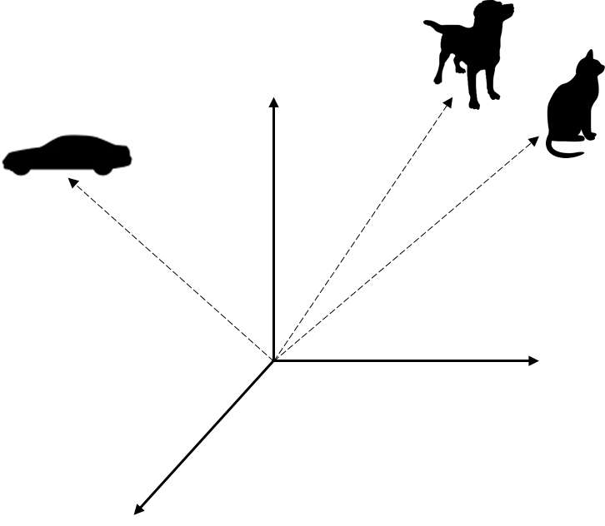
Embeddings
The vectors we have been discussing so far are very high-dimensional (thousands, or even millions) and sparse.
But there are techniques to learn lower-dimensional dense vectors for words using the same intuitions.
These dense vectors are called embeddings.

Slide 15
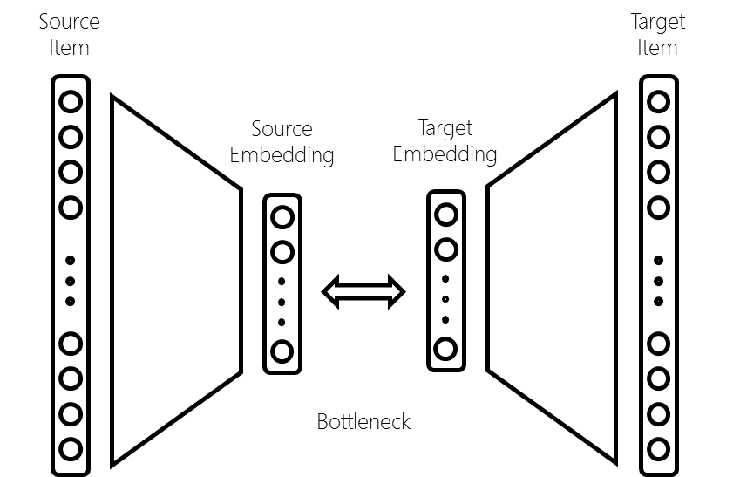
Learning Dense Embeddings
Matrix Factorization
Neural Networks
Factorize word-context matrix.
E.g.,
LDA (Word-Document),
GloVe (Word-NeighboringWord)
A neural network with a bottleneck, word and context as input and output respectively.
E.g.,
Word2vec (Word-NeighboringWord)
 | Context₁ | Context₁ | …. | Context_{k}
Word₁
Word₂
⁞
Word_{n}
Deerwester, Dumais, Landauer, Furnas, and Harshman, Indexing by latent semantic analysis, JASIS, 1990.
Pennington, Socher, and Manning, GloVe: Global Vectors for Word Representation, EMNLP, 2014.
Mikolov, Sutskever, Chen, Corrado, and Dean, Distributed representations of words and phrases and their compositionality, NIPS, 2013.

Slide 16
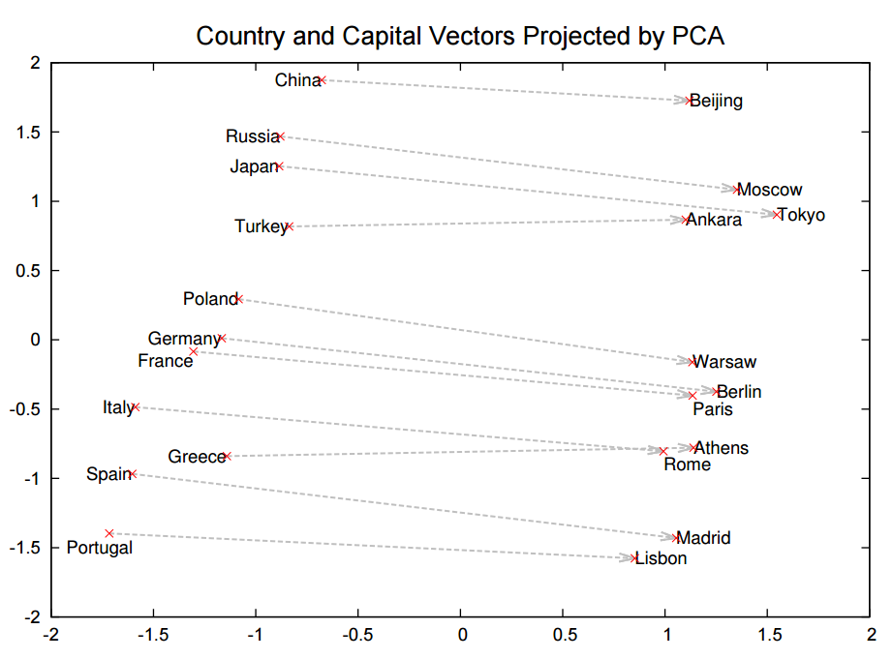
How do word analogies work?
Visually, the vector {china → beijing} turns out to be almost parallel to the vector {russia → moscow}.
But if you aren’t queasy about reading a lot of equations, read the following paper…
Arora, et al. RAND-WALK: A Latent Variable Model Approach to Word Embeddings, 2015.
Mikolov, Sutskever, Chen, Corrado, and Dean, Distributed representations of words and phrases and their compositionality, NIPS, 2013.

Slide 17
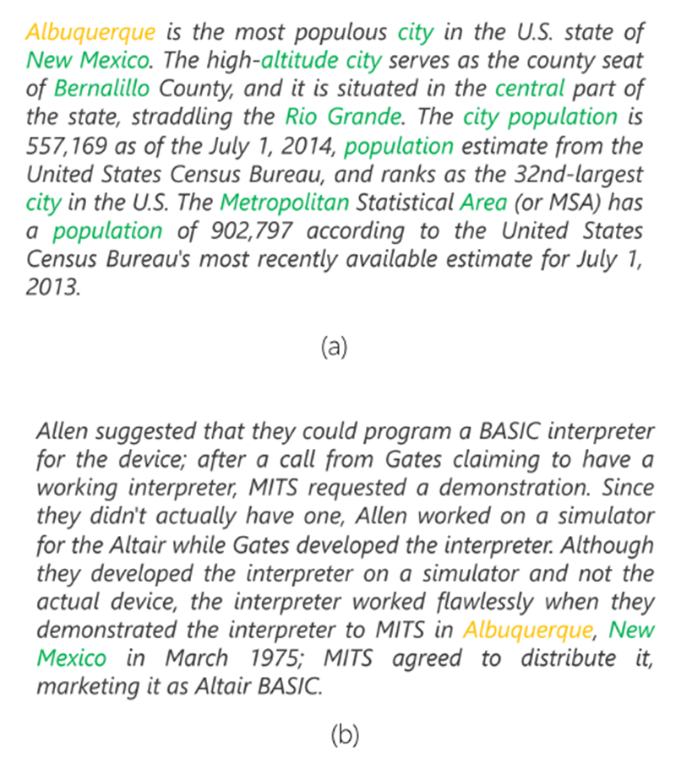
Word embeddings for Document Ranking
Traditional IR uses Term matching,
→ # of times the doc says Albuquerque
We can use word embeddings to compare all-pairs of query-document terms,
→ # of terms in the doc that relate to Albuquerque
Passage about Albuquerque
Passage not about Albuquerque
Nalisnick, Mitra, Craswell, and Caruana, Improving Document Ranking with Dual Word Embeddings, in WWW, 2016.
Mitra, Nalisnick, Craswell, and Caruana, A Dual Embedding Space Model for Document Ranking, arXiv:1602.01137, 2016

Slide 18
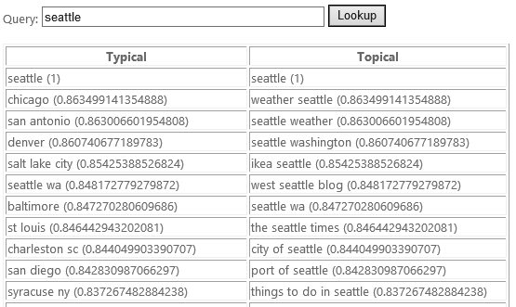
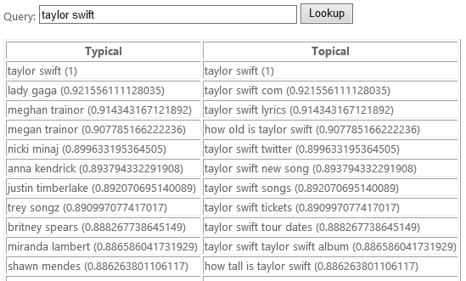
Beyond words…
Deep Semantic Similarity Model (DSSM) trains on multi-word short-text. Like with word embeddings, you can train them to capture either Typical or Topical relationships.
Huang, Po-Sen, et al., Learning deep structured semantic models for web search using clickthrough data, CIKM, 2013.
Mitra and Craswell, Query Auto-Completion for Rare Prefixes, in CIKM, 2015.

Slide 19
What’s next?
Train your own or use a pre-trained embedding
Word2vec
Word2vec trained on queries
GloVe
DSSM
Get your hands dirty and try to build some fun demos!

Slide 20
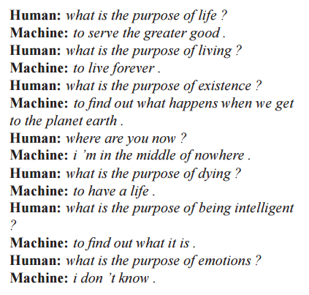
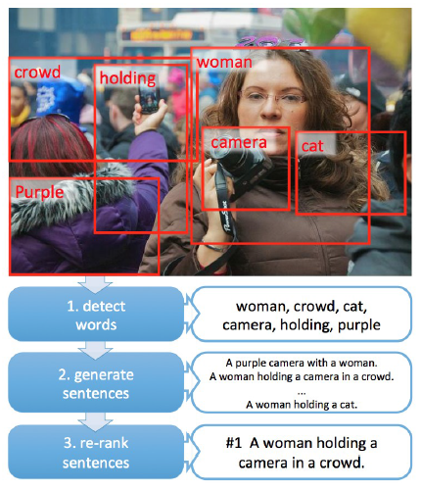
Remember these are exciting times…
Fang et. al., From Captions to Visual Concepts and Back, CVPR, 2015.
Vinyals et. al., A Neural Conversational Model, ICML, 2015.

Slide 21

Thank you for listening!

Slide 22
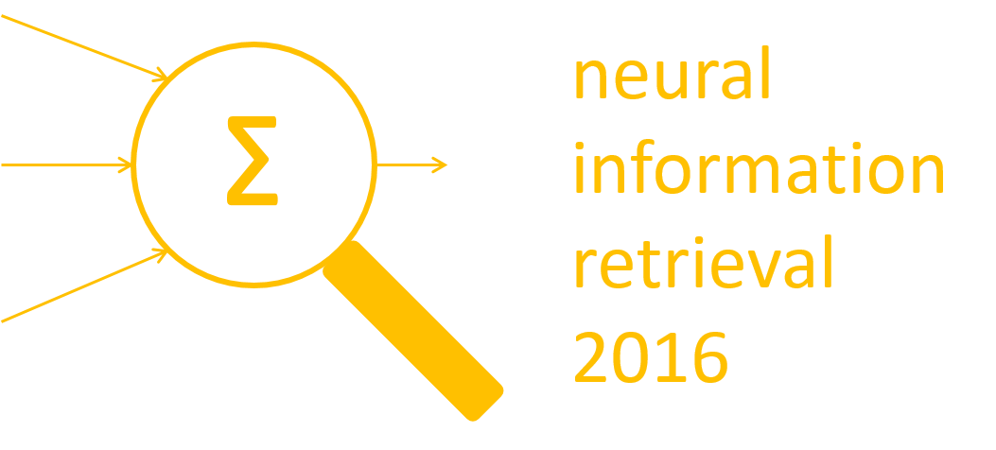
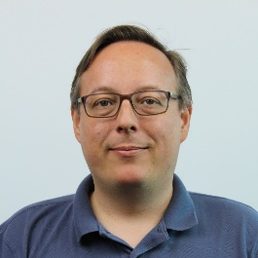

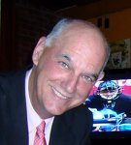
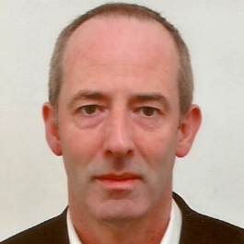

Neu-IR 2016
(Call for Participation)
The SIGIR 2016 Workshop on Neural Information Retrieval
July 21st, 2016
Pisa, Tuscany, Italy
http://research.microsoft.com/neuir2016
https://twitter.com/neuir2016
Organizers
Nick Craswell
Bing, Microsoft
Bellevue, US
Bhaskar Mitra
Bing, Microsoft
Cambridge, UK
W. Bruce Croft
University of Massachusetts
Amherst, US
Maarten de Rijke
University of Amsterdam
Amsterdam, The Netherlands
Jiafeng Guo
Chinese Academy of Sciences
Beijing, China

